Slide 1
What can we measure?
1-D
Measuring …
3-D
2-D

Slide 2
We can measure…
for example: measuring the side of a shape,
the length of a field, your height,
the perimeter of any shape,
the circumference of a circle,…
1-Dimensional Length,
2-Dimensional Area,
3-Dimensional Volume / Capacity,
for example: measuring the area of a shape,
the area of a field, the area of a circle,
the surface area of a solid shape, …
for example: measuring the volume of a
3- dimensional (solid) shape,
the capacity of a container, …

Slide 3
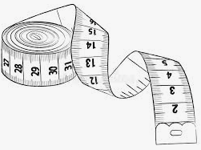
1-D
Measuring …
Length
1-Dimensional
Describe what type of 1-D things we might measure and some standard units we might use.
What is the perimeter of a shape?

Slide 4
1-D
Measuring …
1-Dimensional
The length of a line is
Lengths are measured in standard units, such as:
millimetres (mm)
centimetres (cm)
metres (m)
kilometres (km)
Perimeter is a measure of length; it is the total distance around a shape.
Note: The old Imperial units for length are: inches, feet, yards and miles.
Length
how long it is.
1 centimetre (cm) = 10 millimetres (mm) 1 metre (m) = 100 centimetres (cm) 1 kilometre (km) = 1000 metres (m) = 100 000 centimetres (cm) = 1 000 000 millimetres (mm)

Slide 5
Measuring …
Area
2-Dimensional
2-D
Describe what type of 2-D things we might measure and some standard units we might use.

Slide 6
Measuring …
Area
2-Dimensional
The area of a shape is
Areas are measured in squares
Standard units include:
square millimetres (mm²)
square centimetres (cm²)
square metres (m²)
square kilometres (km²)
Note: The old Imperial units for area are: square inches, square feet, square yards, square miles and acres.
2-D
the size of the surface it covers.
1 square unit:
1 square centimetre (cm²) = 100 square millimetres (mm²) 1 square metre (m²) = 10 000 square centimetres (cm²) 1 square kilometre (km²) = 1 000 000 square metres (m²)

Slide 7
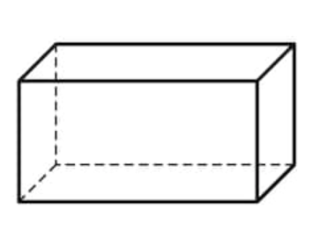
Measuring …
Capacity
3-Dimensional /
Volume
3-D
Describe what type of 3-D things we might measure and some standard units we might use.

Slide 8
Measuring …
Volume
Capacity
3-Dimensional /
3-D
Volume is the amount of…
3-dimensional space something takes up.
Volume is measured in standard units: Capacity is measured in standard units:
Note: The old Imperial units for capacity include: fluid ounces, pints and gallons
Capacity is the amount of…
substance the 3-dimensional shape can hold.
cubic millimetres (mm²)
cubic centimetres (cm²)
cubic metres (m²)
millilitres (ml)
centiltres (cl)
litres (l)
1 centilitre (cl) = 10 millilitres (ml) 1 litre (l) = 100 centilitres (cl) = 1 000 millitres (ml)
1 cubic centimetre (cm³) = 1000 cubic millimetres (mm³) 1 cubic metre (m³) = 1 000 000 cubic centimetres (cm³)

Slide 9
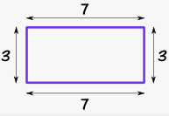
Perimeter
How do we work out the perimeter of a shape?
What do we call the perimeter of a circle?

Slide 10
Perimeter is a measure of .
length
It is the total distance (the length) around a 2-dimensional shape.
(Imagine stretching a piece of string around the outside of the shape; how long is the string?)
Perimeter is
The perimeter of a circle is called the
7 + 3 + 7 + 3 = 20 cm
circumference

Slide 11
What are Compound Shapes? and What can we calculate?

Slide 12
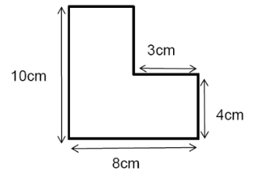
Compound Shapes (or Composite Shapes) … are shapes which can be split into basic shapes, such as rectangles and triangles.
Perimeter: to find the perimeter of a Compound Shape:
First find any missing lengths (sides).
Sum up all the lengths.
Perimeter is: 3 + 4 + 8 + 10 + 5 + 6 = 36 cm
Area: To find the area of a Compound Shape:
Split the compound shape into simple shapes.
Find the area for each simple shape.
Sum the areas.
Area is (5 x 6) + (8 x 4) = 62 cm² or
This side is missing;
it is 5 cm
This side is missing;
it is 6 cm
(5 x 6)
(8 x 4)
Area is (5 x 10) + (3 x 4) = 62 cm²

Slide 13
What parts of the circle can you name?
Circles

Slide 14
Circumference
Circles
– is the perimeter of the circle
Radius
– is the distance from the centre to the cirumference
Diameter
– is the distance from one point on the circumference, through the centre to another point on the circumference

Slide 15
T Ch
5 Ways of Showing (Presenting)
Data
L Graph
Pic
Pie C
Bar C
How many ways can you name? Describe them and say what key information must you have.
Here are some clues…
(The order is not relevant.)

Slide 16
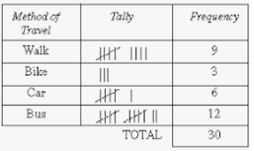
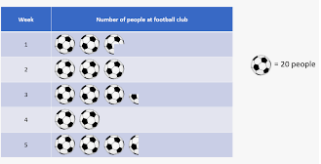
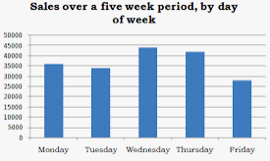
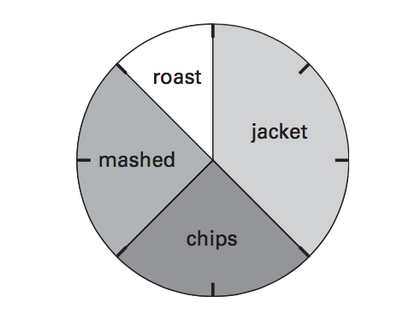
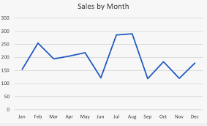
Five Ways of Showing (Presenting) Data:
Tally marks are a way of keeping count by drawing marks.
Every 5th mark is drawn across the previous 4 marks, so bundles of 5 marks can be easily seen and easily counted.
Tables provide one way of presenting data, using rows and columns.
Tally Charts/ Tables
Pictograms
Bar Charts
Pie Charts
Line Graphs
Pictograms use images (i.e. pictures) to represent numbers.
The key on a pictogram shows what each image stands for.
In a bar chart, there is one bar for each category of data.
Make sure your bars are equal width. And make sure the gaps between your bars are the same.
It is the height of a bar which is important; the height of the bar indicates the frequency (how much) of the data in that category.
A pie chart shows the proportion of each category, through a ‘slice’ (or share) of the pie.
What fraction of the class like each potato type best?
Points are connected by lines to show how something changes in value, for example as time goes by.
What was the difference in sales between June and July?

Slide 17
e
$$\frac{a}{b}$$
What do you see?
What is different?
What is the same?

Slide 18
equivalent fractions
Equivalent fractions are all equal, even if they look different.
$$\frac{3}{4}$$
$$\frac{9}{12}$$
$$\frac{18}{24}$$
To find an equivalent fraction, multiply (or divide) the
numerator and the denominatorby the same amount.
$×$ 3
$×$ 2
$$\frac{18}{24}$$
$$\frac{3}{4}$$
$$\frac{9}{12}$$
$×$ 3
$×$ 2

Slide 19
What are Numbers?
Square
List the first 12
This is a square number.
It is 25
You can make a square
out of 25 dots!

Slide 20
Square Numbers .
… are made by multiplying a number by itself.
1 x 1 2 x 2 3 x 3 4 x 4 5 x 5 6 x 6
1² 2² 3² 4² 5² 6²
(^{we say this as ‘3 squared’})
1 4 9 16 25 36
The first 12 square numbers are:
1 4 9 16 25 36 49 64 81 100 121 144
(1²) (2²) (3²) (4²) (5²) (6²) (7²) (8²) (9²) (10²) (11²) (12²)

Slide 21
Convert between Top Heavy Fraction and Mixed Number.
_{I}
_{N} _{n}
__ __
D D
Pick a top heavy fraction for your partner. Ask them to convert.
Pick a mixed number for your partner. Ask them to convert.
*
*
_{I}
= integer (i.e. whole number)

Slide 22
Improper Fraction Mixed Number
Quick way: 19 ➗ 5 = 3 remainder 4; Answer 3 $\frac{4}{5}$
For example:
3
Notes:
The denominator always stays the same.
To convert from Improper Fraction to Mixed Number: Five fifths make a whole, so we ask how many ‘5’s (and therefore ‘wholes’) can we make from 19? Answer: 3 with 4 left over, so we have 3 ‘whole’ and 4 fifths remaining.
To convert from Mixed Number to Improper Fraction: Five fifths make a whole, so 3 ‘whole’ would be 3 x 5 fifths i.e. 15 fifths. With the extra 4 fifths, this makes a total of 19 fifths.
$$\frac{19}{5}$$
$$\frac{4}{5}$$
Quick way: 5 x 3 + 4 = 19;
Answer $\frac{19}{5}$

Slide 23
Can you name the parts of the shape? (How many of each are there?)
Clues:
And what is this an
example of?

Slide 24
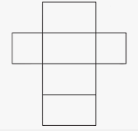
3-D Shapes: Cuboid
Number of Faces | Number of Vertices | Number of Edges
6 | 8 | 12
A net is an unfolded 3-dimensional shape laid flat
(imagine unfolding a cereal box).
There can be more than one way to make a net for the same 3-D shape.

Slide 25
Inequality Symbols < = >
Match the symbols with the words
‘Greater than’
‘Equal to’
‘Less than’

Slide 26
< = >
a < b c = d e > f
a ‘is less than’ b c ‘equals’ d e ‘is greater than’ f
1 < 3 2 = 2 3 > 1
Other examples:
12 < 20 6 = 6 15 > 9
5 + 3 < 6 + 4 2 + 5 = 6 + 1 10 - 2 > 1 + 6
10 $÷$ 2 < 12 $÷$ 2 4 x 3 = 24 $÷$ 2 18 $÷$ 3 > 20 $÷$ 4
2
2
1
3
3
1

Slide 27
How many averages can you name? Describe them and say how you work them out.
M
Averages
M
M

Slide 28
There are 3 averages:
Averages
ean
Add up all the values you have; this is the total.
Then divide by how many values you have
This is the most common value in your data set.
This is the middle data value, once all the data values have first been placed in order of size
$$\frac{Total}{number of values}$$
Mean =
ode
Mode = Most common
edian
Median = Middle data value
(once data ordered)

Slide 29
Expressions and Equations
What is the difference between the two?

Slide 30
Expressions and Equations
An expression is a collection of terms and symbols.
Examples: 2n + 1; x + 3; 3a + 8
An equation will have an equals sign ‘=’ and both sides of an equation must balance (i.e. have equal value).
Equations can be solved.
Examples: 2n + 1 = 9 x + 3 = 5 3a + 8 = 29
Solutions: n = 4 x = 2 a = 7

Slide 31
What are Sequences?
3
7
11
20
17
14

Slide 32
Sequences
Sequences follow a pattern according to a rule.
3 7 15 19 27
This sequence starts at 3 and follows the rule of ‘adding 4’
(Find the missing numbers.)
The next sequence below starts at 20 and follows the rule of ‘subtracting 3’.
20 17 14 8 5
Can you make up some of your own? Try starting one with a negative number.
11
23
11
2

Slide 33
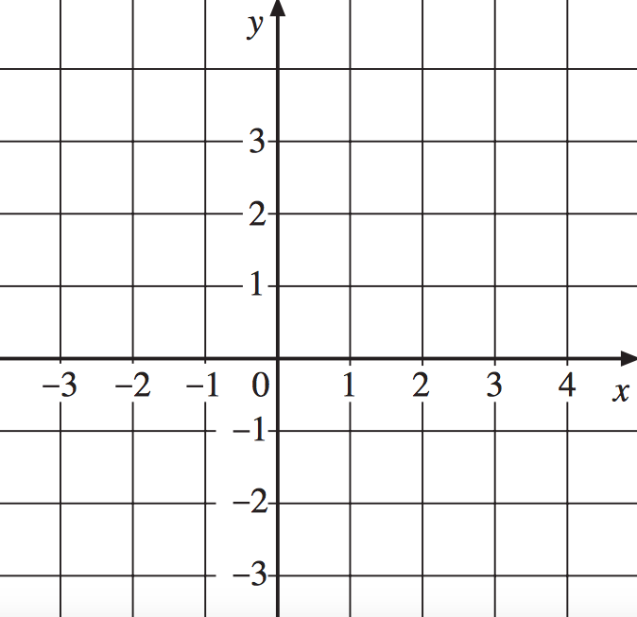
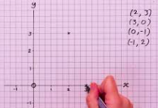
Coordinates (x, y)
Plot the points:
A at (2, 3)
B at (3, 0)
C at (0, -1)
D at (-1, 2)
E at (4, 3)
F at (-3, -2)

Slide 34
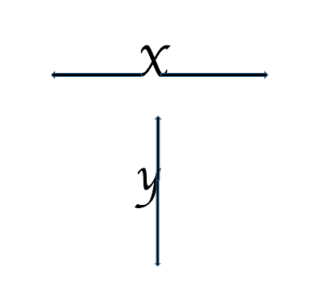
Coordinates (x, y)
The x-coordinate gives the
position along the x-axis
(horizontal line).
The y-coordinate gives the
position along the y-axis
(vertical line).
_{x}A
_{x}E
_{x}D
_{x}B
_{x}C
_{x}F
Plot the points:
A at (2, 3)
B at (3, 0)
C at (0, -1)
D at (-1, 2)
E at (4, 3)
F at (-3, -2)

Slide 35
En_ _ _ _ _ _ _ _ _
Re_ _ _ _ _ _ _ _
How many can you name?
Transformations
Tr _ _ _ _ _ _ _ _ _
Ro_ _ _ _ _ _
Clues:
Describe their key features.

Slide 36
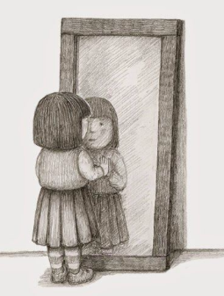
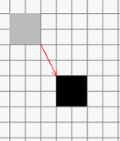
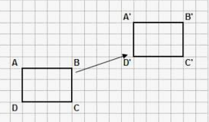
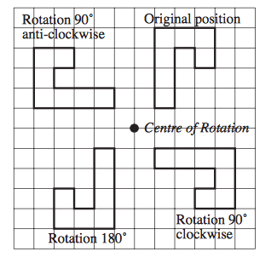
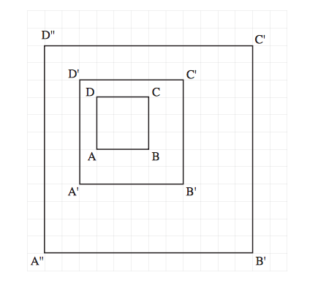
There are 4 transformations
Transformation
An image or picture as it would be seen in a mirror.
A reflection flips a shape.
There is NO rotating or sliding.
Mirror lines can be horizontal, vertical or diagonal.
Reflections change the position of a shape but do NOT change its size.
Reflection
Translation
Rotation
Enlargement
A translation means to move or slide – without rotating or flipping the shape.
The shape will still look exactly the same, just in a different place.
The shape can be moved horizontally (i.e. to the left or to the right).
The shape can be moved vertically (i.e. up or down).
The shape can be moved both horizontally and vertically.
Rotations rotate a shape about a fixed point, called the centre of rotation,
through a specified angle.
An enlargement is a transformation which enlarges (or reduces) the size of an image.
An enlargement is described by:
a centre of enlargement
a scale factor

Slide 37
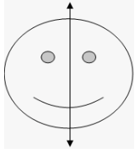
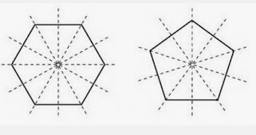
Reflective Symmetry or Line Symmetry
Describe what you know about reflective symmetry.
How many lines of symmetry do these shapes have?

Slide 38
Reflective Symmetry or Line Symmetry
A shape has line symmetry (reflective symmetry) if you can fold the shape in half along a line so that both halves match exactly.
The folding line is called the line of symmetry.
Shapes can have no lines of symmetry
Shapes can have 1 line of symmetry
Shapes can have 2 lines of symmetry
Shapes can have 3 lines of symmetry or 4 or 5 or 6 or...
These shapes have 5 and 6 lines of symmetry, respectively:
(remember to count the whole line)

Slide 39
I
V
X
L
C
D
M
CXII =
MD =
VIII =
XIV =
LXXX =
MCLXXX =

Slide 40
Roman Numerals
I = 1
V = 5
X = 10
L = 50
C = 100
D = 500
M = 1000
Consider how the system works:
IV = 4 1X = 9 XL = 40
V = 5 X = 10 L = 50
V1= 6 XI= 11 LX= 60
XC = 90 CD = 400 CM = 900
C = 100 D = 500 M = 1000
CXII = 112
MD = 1500
VIII = 8
XIV = 14
LXXX = 80
MCLXXX =1180
CX = 110 DC = 600 MC = 1100

Slide 41
Percentage – what do you know?
What is 62% 0f 200?
What is 35% of 50?

Slide 42
means out of 100
What is 62% of 200?
For each 100 there will be 62 parts,
so for 200 there will be
62 $×$ 2 (as there are 2 lots of 100) parts,
which equals 124
Per cent age
‘parts per 100’
25 % =
25 ‘parts’ out of 100
25 % = $\frac{25}{100}$
What is 35% of 50?
For each 100 there will be 35 parts,
so for 50 there will be
35 $÷$ 2 (as 50 is half of 100) parts,
which equals 17.5

Slide 43
How do you convert between Fractions, Decimals and Percentages?
Fraction
$$\frac{Percentage}{100}$$
$\frac{N}{D}$ = N $÷$ D
and then
simplify
if needed
Decimal
Percentage
Try converting $\frac{ 2}{5}$ into a decimal
and then into a percentage.
Now try converting any other amount.
UNIT: Percentages
Section 1
Decimal x 100%

Slide 44
Converting… $\frac{ 2}{5}$
$$\frac{2}{5}$$
Fraction
$$\frac{2}{5}$$
$$\frac{40}{100}$$
$\frac{2}{5}$ = 2 $÷$ 5
= $\frac{20}{50}$
= 0.4
= $\frac{2}{5}$
Decimal
Percentage
0.4
40%
UNIT: Percentages
Section 1
0.4 x 100%

Slide 45
Place Value
? | 100 000 Hth | ? | ? | ? | ? | ? | ? | ? | $$\frac{1}{1000}$$ th
 |  |  | 1 | 3 | 7 | 2
 | 8 | 3 | 9 | 1 | 2 | 1
 |  |  |  | 6 | 3 | 0
 |  | 2 | 3 | 4 | 5 | 1
3 | 2 | 5 | 4 | 1 | 7 | 9
 |  |  |  | 4 | 5 | 1 | 3
 |  |  |  |  |  | 0 | 0 | 0 | 3
 |  |  |  |  | 1 | 2 | 0 | 3 | 5
What are the missing headings?
What is the value of 3 in each of the numbers?

Slide 46
Place Value
1 000 000 M | 100 000 Hth | 10 000 Tth | 1000 Th | 100 H | 1 T | 1 O | $$\frac{1}{10}$$ t | $$\frac{1}{100}$$ h | $$\frac{1}{1000}$$ th
 |  |  | 1 | 3 | 7 | 2
 | 8 | 3 | 9 | 1 | 2 | 1
 |  |  |  | 6 | 3 | 0
 |  | 2 | 3 | 4 | 5 | 1
3 | 2 | 5 | 4 | 1 | 7 | 9
 |  |  |  | 4 | 5 | 1 | 3
 |  |  |  |  |  | 0 | 0 | 0 | 3
 |  |  |  |  | 1 | 2 | 0 | 3 | 5
(a)
(b)
(c)
(d)
(e)
(f)
(g)
(h)
(a)
3 hundred
30 thousand
thirty
3 thousand
3 million
3 tenths
3 thousandths
3 hundredths
(b)
(c)
(d)
(e)
(f)
(g)
(h)

Slide 47
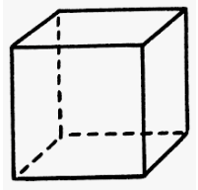
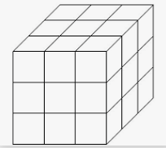
What are Cube Numbers?
Can you list some?

Slide 48
Cube Numbers . . .
… are made by multiplying a number by itself, by itself.
1 x 1 x 1 2 x 2 x 2 3 x 3 x 3 4 x 4 x 4 5 x 5 x 5 6 x 6 x 6
1³ 2³ 3³ 4³ 5³ 6³
(^{we say this as ‘4 cubed’})
1 8 27 64 125 216
The first 10 cube numbers are:
1 8 27 64 125 216 343 512 729 1000
(1³) (2³) (3³) (4³) (5³) (6³) (7³) (8³) (9³) (10³)

Slide 49
Numbers can be …
0
$−$ +
What is the difference between $−$5 and 3?
What is $−$2 + 7?
What is $−$2 $−$7?
What is the difference between 4 and $−$8?
Can you make up some questions of your own?

Slide 50
Negative numbers are less than zero Positive numbers are more than zero Zero is neither positive nor negative
The difference between $−$5 and 3 is 8
$−$2 + 7 = 5
$−$2 $−$7 = $−$9
The difference between 4 and $−$8 is 12

Slide 51
Factors are…?
x =
f
f
f
List all the factors of 12?
Of 72?
Of 18?

Slide 52
Factors…
… are numbers we multiply together to get another number
3 x 4 = 12
3 and 4 are factors of 12, because 3 x 4 = 12
We can list all the factors of a number, by using factor pairs:
1 x 12 = 12
2 x 6 = 12
3 x 4 = 12
1 x 72 = 72
2 x 36 = 72
3 x 24 = 72
4 x 18 = 72
6 x 12 = 72
8 x 9 = 72
The factors of 12 are:
1, 2, 3, 4, 6, 12
The factors of 72 are:
1, 2, 3, 4, 6, 8, 9, 12, 18, 24, 36, 72
The factors of 18 are: 1, 2, 3, 6, 9, 18

Slide 53
Prime Numbers are…
1
How many can you list?
Why is there only one even prime number?

Slide 54
Prime Numbers…
… are numbers which have only two factors: 1 and itself.
2 is the only even prime number,
because 2 will be a factor of every other even number.
1 2 3 4 5 6 7 8 9 10
11 12 13 14 15 16 17 18 19 20
21 22 23 24 25 26 27 28 29 30
31 32 33 34 35 36 37 …
Can you find the next 3?

Slide 55
Product of Prime Factors…
M
By drawing a factor tree
can you find 72
as a product of primes?

Slide 56
Product of Prime Factors…
… can be found using a factor tree diagram.
(Note: there may be many different ways to draw the tree, each giving the same final solution.)
72
2
36
2
18
2
9
3
3
72 = 2 x 2 x 2 x 3 x 3

Slide 57
Multiples are …?
$×$ =
M
List some multiples of 2
List some multiples of 3
List some multiples of 6
List some multiples of [you choose]

Slide 58
Multiples are …
… the result of multiplying one number (factor) by another.
1 x 2 = 2 1 x 3 = 3 1 x 4 = 4 1 x 6 = 6 1 x 12 = 12
2 x 2 = 4 2 x 3 = 6 2 x 4 = 8 2 x 6 = 12 2 x 12 = 24
3 x 2 = 6 3 x 3 = 9 3 x 4 = 12 3 x 6 = 18 …
4 x 2 = 8 4 x 3 = 12 4 x 4 = 16 4 x 6 = 24
5 x 2 = 10 5 x 3 = 15 5 x 4 = 20 5 x 6 = 30
6 x 2 = 12 … … …
…
is a multiple of 2 and a multiple of 3 and a multiple of 4 and
a multiple of 6 and a multiple of 12 (it is also a multiple of 1).
12

Slide 59
Ratio and Proportion
Describe what you know about ratio and proportion. What is the difference between them?
What is the proportion of blue counters?
What is the proportion of red counters?
What is the ratio of blue to red counters?
What is the ratio of red to blue counters?

Slide 60
Ratio and Proportion compares ‘part’ with ‘part’ compares ‘part’ with ‘whole’ (or total)
7 parts in total
Ratio 3 : 4
(we read this as ‘ 3 to 4’, so for every
3 blue counters there will be 4 red ones)
Ratio of red: blue is 4:3
Proportion of Blue $\frac{3}{7}$
Proportion of Red $\frac{4}{7}$

Slide 61
What do you see?
P
P
P

Slide 62
Parallel Lines are always the same distance apart
Perpendicular Lines meet at right-angles to each other
Polygons are closed 2-D shapes with straight sides A polygon is a ‘regular polygon’ if all sides are equal and all angles are equal.
Otherwise it is an ‘irregular polygon’.

Slide 63
Triangles
?
Can you name the different type of triangles?
What do you know about them?

Slide 64
Triangles
These triangles may be right-angled
A right-angled triangle
has one 90º angle
Scalene
Isosceles
No sides equal
No angles equal
Can be right-angled
Two sides equal
Two angles equal
Can be right-angled
Equilateral
All sides equal
All angles equal (60º)
Cannot be right-angled

Slide 65
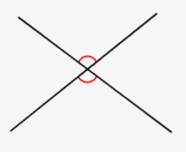
Angles and Degrees (º)
Angles are measured in units called _______
There are _____ in a complete turn
Angles on a straight line add up to _____
Angles that meet at a point add up to _____
Angles within a triangle add up to _____
Angles within a quadrilateral add up to _____
Angles that are vertically opposite are _________

Slide 66
Angles and degrees (º)
Angles are measured in units called degrees (º)
There are 360º in a complete turn
Angles on a straight line add up to 180º
Angles that meet at a point add up to 360º
Angles within a triangle add up to 180º
Angles within a quadrilateral add up to 360º
Angles that are vertically opposite are equal

Slide 67
Formula (plural: Formulae)
width (w)
height (h)
length (l)
base (b)
length (l)
height (h)
width (w)
Do you know the formulae for these shapes?

Slide 68
Formula (plural: Formulae)
A formula is a rule for working something out.
It has unknown numbers in it.
These unknown numbers are usually shown as letters.
Examples of formulae:
Area of triangle = ½ x b x h Volume of cuboid = l x w x h
Area of rectangle = l x w

Slide 69
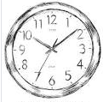
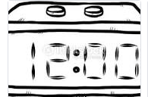
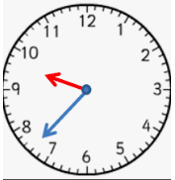
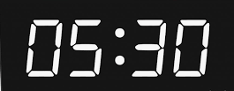
Describe Analogue Time and Digital Time

Slide 70
Time
Time can be shown as Analogue, with a clock face
or
Time can be shown as Digital, using numbers only
Analogue time uses:
‘am’ for times between midnight and noon, and
‘pm’ for times between noon and midnight,
e.g. 3pm is 3 ‘o’ clock in the afternoon.
Digital time can be shown by a 12-hour clock
or
Digital time can shown by a 24-hour clock

Slide 71
Can you convert analogue time to 24-hour digital time?
12-hour analogue time | 24-hour digital time
9 am | ?
? | 10:30
? | 12:15
? | 15:25
8.15 pm | ?
11 pm | ?
11.59pm | ?
? | 00:04
2 am | ?
Digital
Analogue

Slide 72
12-hour analogue time | 24-hour digital time
9 am | 09:00
10.30 am | 10:30
12.15pm | 12:15
3.25 pm | 15:25
8.15 pm | 20:15
11 pm | 23:00
11.59pm | 23:59
12.04 am | 00:04
2 am | 02:00

Slide 73
Time What do these amounts represent?
60 60
24 7 365
52 12

Slide 74
There are 60 seconds in a minute.
There are 60 minutes in an hour.
There are 24 hours in a day.
There are 7 days in a week.
There are 365 days in a year (366 in a leap year).
There are 52 weeks in a year.
There are 12 months in a year.

